Slide 1

estimating kiva loan amounts
Shafiq Jadallah
Capstone 2: supervised learning models
October, 2019

Slide 2
questions about Kiva’s loans
Kiva started in 2005
An crowdsourced microlender established as a 501(c)(3) that allows people to lend money to students and entraprenuers in low-income
Have lent over 1.6M loans totaling over $1.3Bn
Question 1:
Can I estimate a typical Kiva loan amount?
Question 2:
What are the strongest features so that a borrower should know that impacts his/her expected loan amount?

Slide 3
The data sets
KIVA Dataset
Features: 20
Rows: 671,205
Country Stats Dataset
Features: 13
Rows: 174
id 671205
funded_amount 610
loan_amount 479
activity 163
sector 15
use 424912
country_code 86
country 87 region 12695 currency 67
partner_id 366
posted_time 667399
disbursed_time 5719
funded_time 498007
term_in_months 148
lender_count 503
tags 86719
borrower_genders 11298 repayment_interval 4
date 1298
country_name 174
country_code 173 country_code3 173
continent 174
region 174
population 174 population_below_poverty_line 152
hdi 171
life_expectancy 168 expected_years_of_schooling 168
mean_years_of_schooling 168 gni 168
kiva_country_name 174
Pulled data from Kaggle.com
https://www.kaggle.com/mhajabri/kiv-me-a-loan/data
Found additional dataset to complement country profile information
https://www.kaggle.com/codename007/a-very-extensive-kiva-exploratory-analysis/data

Slide 4
Kiva data set: pre adjustments
Original Kiva data set profile:
EDA: Explore, clean, explore some more…
Eliminated <NaN> values through combined technique of filling in through means and dropping rows once <5% of data fields were complete
Treated outliers using winsorize function for one-tailed distribution
Removed any blank spaces
Created categories to convert categorical features from ‘str’ to ‘int’ in order to perform analysis and plotting functions
Final data set: post adjustments
Kiva data set profile after cleaning:

Slide 5
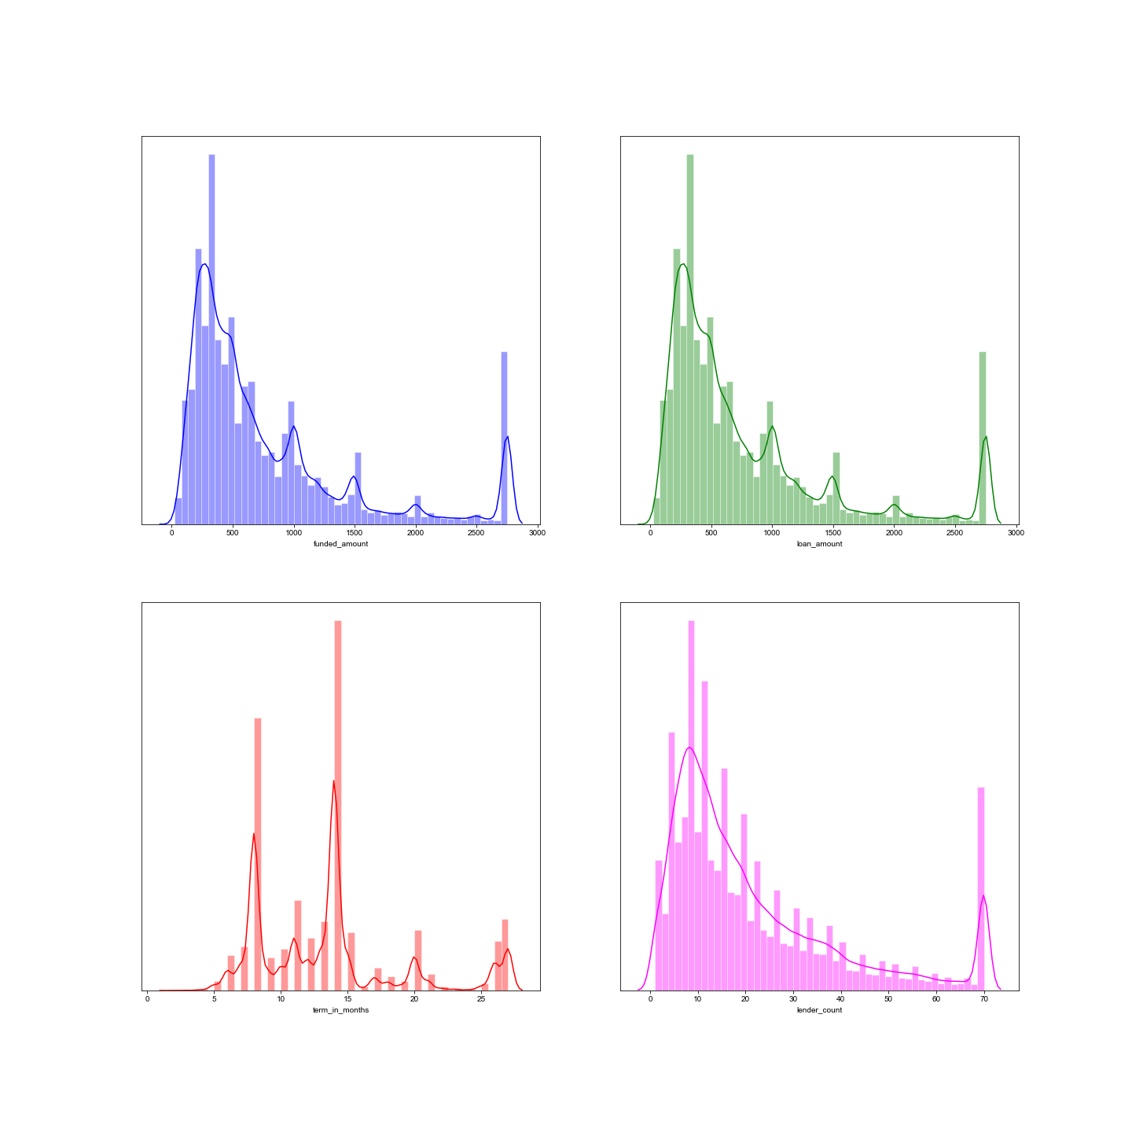
Original Kiva data set profile:
EDA: Explore, clean, explore some more…
Plotted distributions of the four continuous variables within the Kiva dataset.
Kiva data set profile after cleaning:

Slide 6
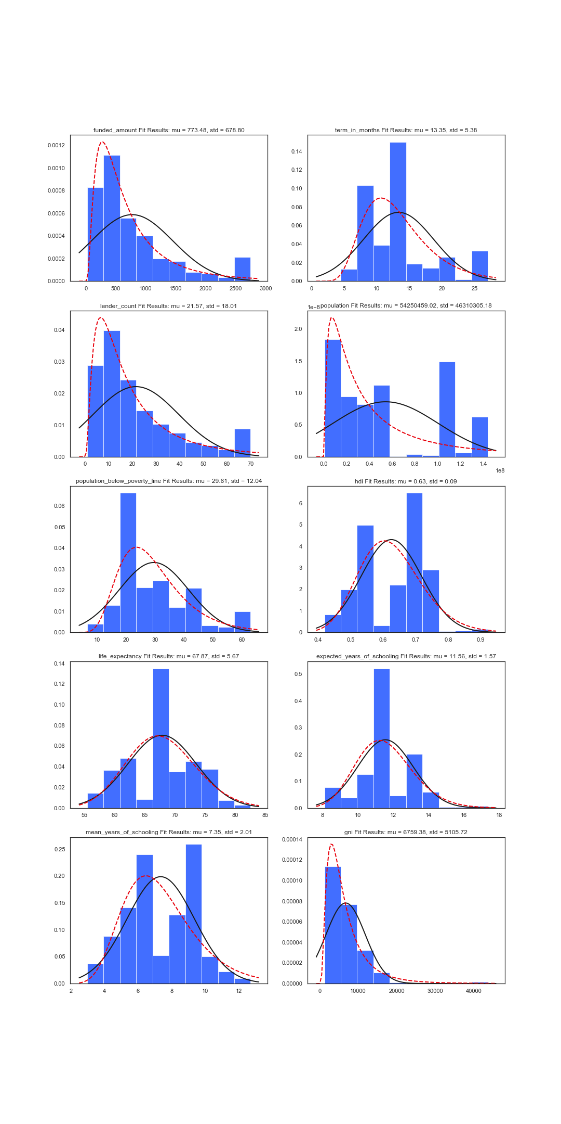
Original Kiva data set profile:
EDA: Explore, clean, explore some more…
Combined country_stats dataset with Kiva dataset
Converted categorical object features into categorical numerical features
Plotted distributions of combined continuous variables
Looked at regular, normal and lognormal distribution of datasets
Black – PDF normal
Red – PDF lognormal
Kiva data set profile after cleaning:

Slide 7
Building the model(s)
Decision regression tree
Gradient & XG Boosting
KNN Regression
OLS Regression
Stats to include:
Sample size
Y = Funded Amount
X features (number)
Results
Accuracy, MSE, MAPE,?
Time
Stats to include:
Sample size
Y = Funded Amount
X features (number)
Results
Accuracy, MSE, MAPE,?
Time
Stats to include:
Sample size
Y = Funded Amount
X features (number)
Results
Accuracy, MSE, MAPE,?
Time
Stats to include:
Sample size
Y = Funded Amount
X features (number)
Results
Accuracy, MSE, MAPE,?
Time

Slide 8
Conclusions:
Estimated funded amount per loan
OLS $
Decision Regression Tree $
KNN $
Top Features for estimated funded amount were:

Slide 9
Next steps
Improve accuracy of model(s)
Discard following models:
Introduction of new features to improve accuracy

